Slide 1
Mobile Recharge
-Kanojesh.T

Slide 2
->Problem Statement
->Objective
->Controller Services
->Project Overview
->Architecture
->Project Flow
->Technologies and Tools Used
->Project Sample
Case Study Outline

Slide 3
Problem Statement

Slide 4
Prepaid online recharges were introduced to offer users greater convenience, flexibility, and control over their mobile or digital services.
Before their advent, users typically relied on postpaid plans, which required monthly payments based on usage.
However, this model came with certain limitations, such as fixed monthly bills and potential overage charges.
The introduction of prepaid online recharges revolutionized the telecommunications industry by allowing users to pay in advance for the services they consume.

Slide 5
This prepaid model provided several advantages.
Firstly, it empowered users with the freedom to choose the amount they wanted to spend and the services they wished to access, without being tied to long-term contracts.
Secondly, it eliminated the risk of unexpected charges, as users could monitor their usage in real-time and top up their accounts as needed.
Lastly, the online aspect of prepaid recharges made the process seamless and accessible, enabling users to recharge from the comfort of their homes or on the go, using various digital platforms and payment methods.
Overall, the introduction of prepaid online recharges marked a significant shift towards a more user-centric and flexible approach to telecommunications, catering to the evolving needs and preferences of consumers in an increasingly digital age.

Slide 6
Objective

Slide 7
Customer Convenience: The primary objective is to provide customers with a convenient and accessible method to recharge their accounts. By offering online recharge options, customers can easily top up their balance from anywhere and at any time, without the need to visit physical stores or outlets.
Flexibility: The prepaid recharge system aims to offer customers flexibility in terms of choosing the amount they want to recharge and the services they wish to avail. This allows customers to tailor their plans according to their usage patterns and budgetary constraints.
Real-Time Monitoring: Another objective is to empower customers with the ability to monitor their usage in real-time. Prepaid customers can track their balance, usage details, and validity periods, enabling them to manage their expenses more effectively and avoid unexpected service interruptions.
Customer Retention: Providing a seamless and user-friendly prepaid recharge experience can contribute to customer satisfaction and loyalty. By meeting customer expectations and offering competitive recharge options, telecom companies can enhance customer retention and reduce churn rates.

Slide 8
Controller Services

Slide 9
Customer Controller
Login/SignUp
Update Profile
Customer Plan Controller
Recharge
Payment
Recharge History

Slide 10
Project Overview

Slide 11
Database
Recharge
Home
Login
UpdateProfile
Register

Slide 12
Architecture

Slide 13
Customer Controller
SQL Server
Get/Put/Post
Front End
Customer Plan Controller
Get/Post

Slide 14
Project Flow

Slide 15
Update
Auto Recharge
Login
Recharge
Payment
User
Recharge History
Register
LogOut

Slide 16
Technologies and
Tools Used

Slide 17





Slide 18
Project Sample

Slide 19
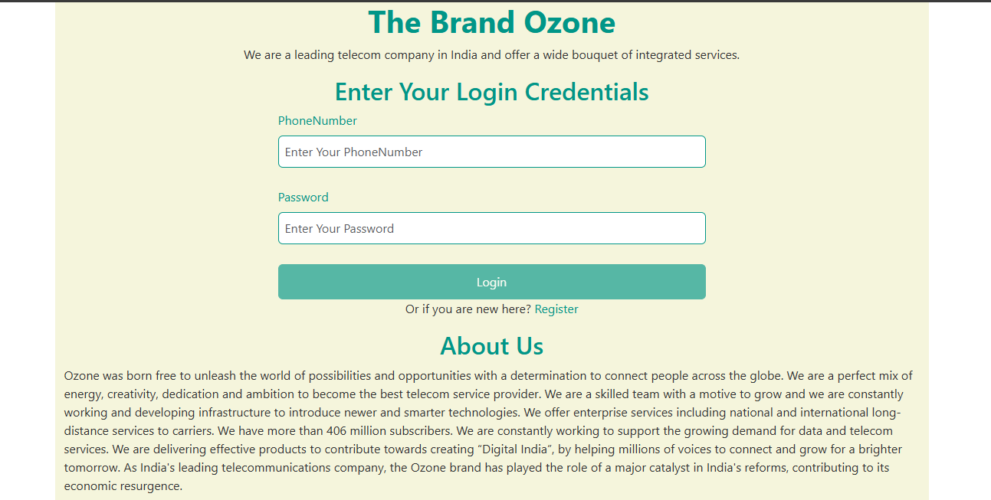

Slide 20
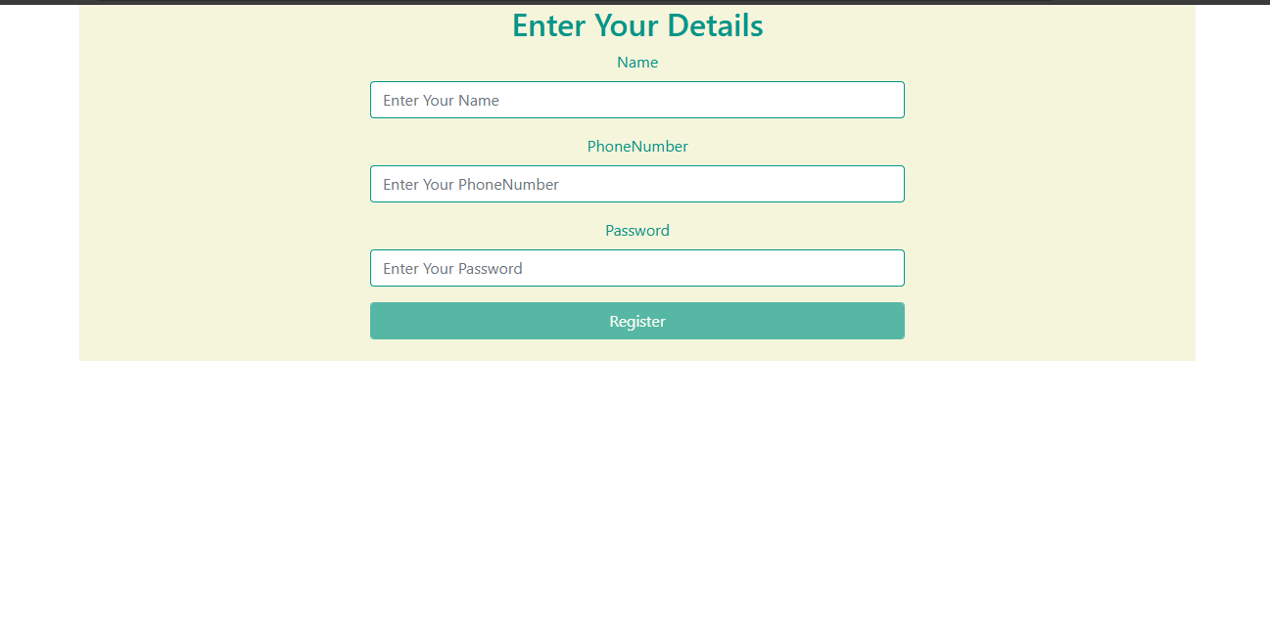

Slide 21
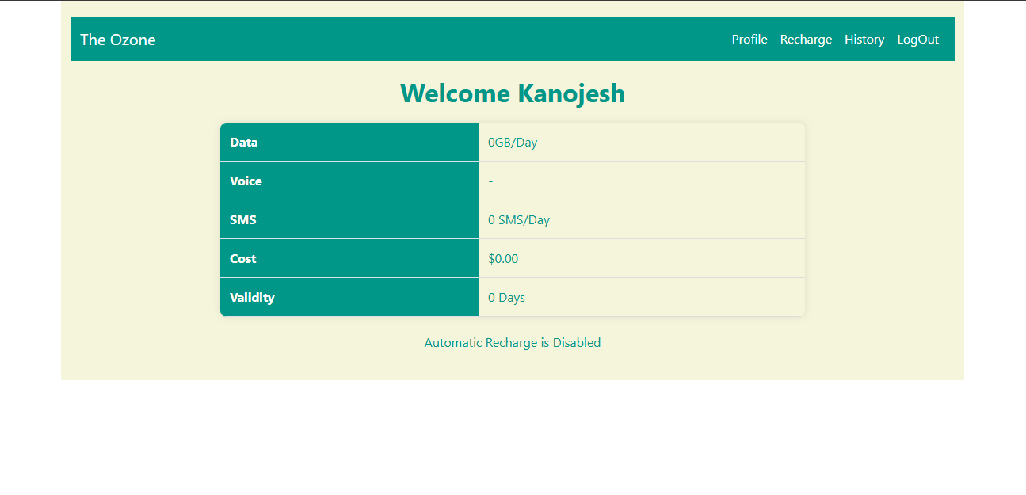

Slide 22
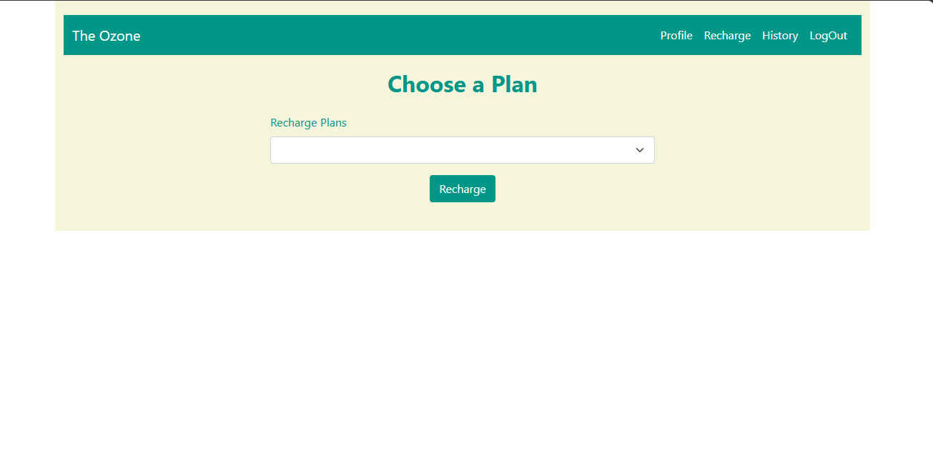

Slide 23
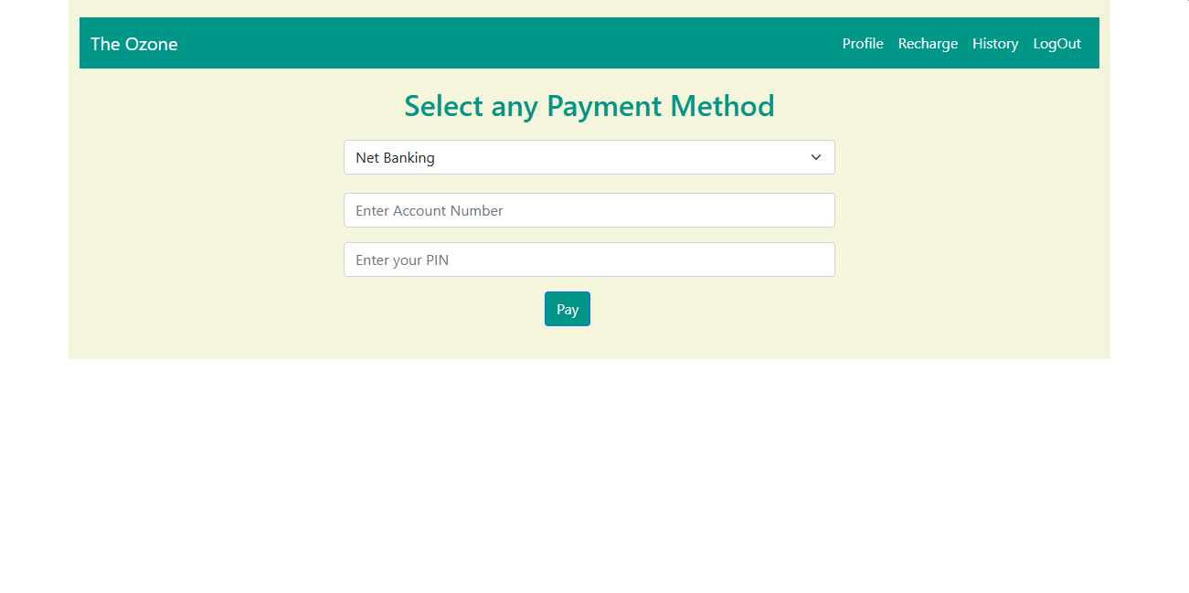

Slide 24
